Slide 1
Face Recognition & Retrieval System
B.Swaroopa.
160101120073
Sri Harsha.J
160101120024

Slide 2
Requirements
Functional Requirements.
Non-Functional Requirements.
Hardware Requirements.
Software Requirements.

Slide 3
Functional Requirements
OS-Windows 10
Database-sqlite
Stored User Data.

Slide 4
Non-Functional Requirements
Usability:-
In this project users face can easily identifies and it calculate time to capture one image and pc cam will automatically generated.
Reliability:-
This System will be reliable because It will give perfect information for users and we are adding the new feature with this project.
Supportability:-
The System should be supported for all pc’s and this project completely, based on python platform.
Implementation:-
We are using python platform for this project and we are adding new software called open cv , import packages like numpy, matplotlib, pip and pillow .
Interface:-
The user interface will completely based on camera this project is completely dynamic. Depends on users expression this project will work.

Slide 5
Hardware Requirements
Processor- Inter CORE i5.
Hard Disc- 1 TB.
RAM-8 GB.
Software Requirements
Operating System-Windows 10.
Coding Language- Python.
Data Base –Sqlite.

Slide 6
Algorithm/Technique
LBP is proposed in 1990. This algorithm improves the detection performance considerably on some datasets .In this project we are using LBP algorithms . LBP means (Local Binary Patterns) In this technique it will scan the users face and it will convert in to patterns in interior part it will calculate into x-axis and y-axis (graph) we will perform one logic using LBP algorithm then finally this project will run.

Slide 7
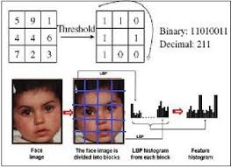
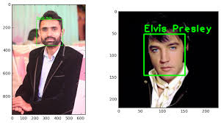
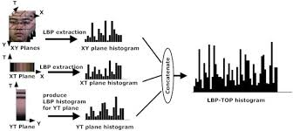

Slide 8
Step-by-Step
1. Parameters: the LBPH uses 4 parameters:
Radius: the radius is used to build the circular local binary pattern and represents the radius around the central pixel. It is usually set to 1.
Grid X: the number of cells in the horizontal direction. The more cells, the finer the grid, the higher the dimensionality of the resulting feature vector. It is usually set to 8.
Grid Y: the number of cells in the vertical direction. The more cells, the finer the grid, the higher the dimensionality of the resulting feature vector. It is usually set to 8.
Don’t worry about the parameters right now, you will understand them after reading the next steps.
2. Applying the LBP operation: The first computational step of the LBPH is to create an intermediate image that describes the original image in a better way, by highlighting the facial characteristics. To do so, the algorithm uses a concept of a sliding window, based on the parameters radius and neighbors.

Slide 9
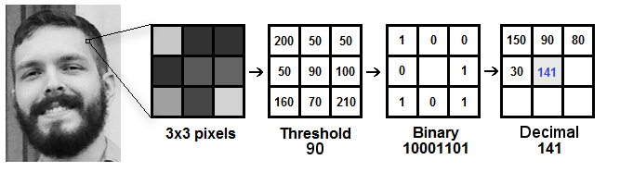
Conclusions
LBPH is one of the easiest face recognition algorithms.
It can represent local features in the images.
It is possible to get great results (mainly in a controlled environment).
It is robust against monotonic gray scale transformations.
It is provided by the OpenCV library (Open Source Computer Vision Library).

Slide 10
Thank You

